Slide 1
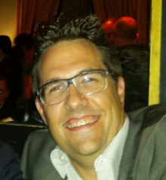

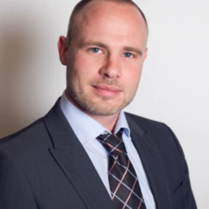
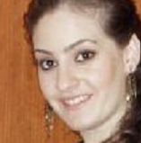
Team Members:
Lorenz Hänggi (Mobile)“Team Leader”
Cedric Wider (Mobile)
Nawar El Husseini
(Data Science)
A Cool App for
“Hunting your Dream Car “
( 9 am ) Sunday Oct-4th 2015)

Slide 2
Mission
Develop a cool, transparent & user friendly iOS App (in 40 hrs) which guides you to your dream car by hunting just the right ones based on who you are

Slide 3
Major Activities that were implemented:
Figure out which attributes are important to filter
Field study at hackZurich (> 15 people)
Make research of the API
Wire framing & navigation actions on high level
Determine which page is dynamic which is static
Design & code for all the details of every page
Implement a static clickable App
Make every page dynamic, bugfixing

Slide 4
How it Works ?

Slide 5
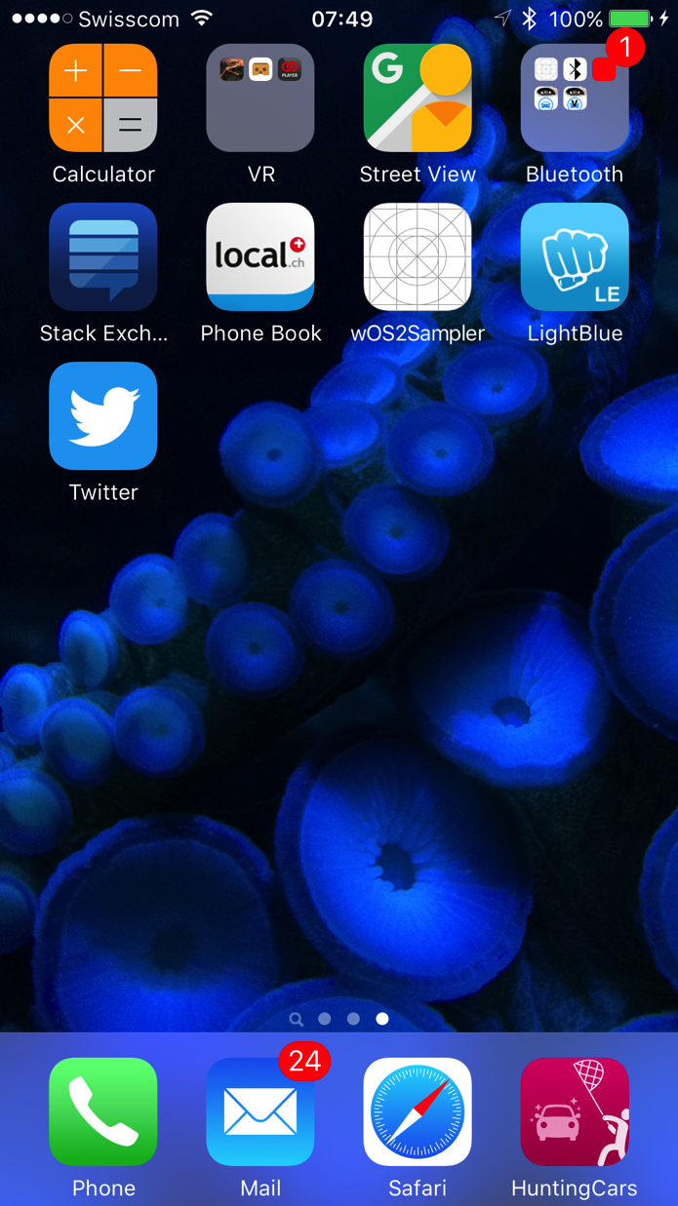

Slide 6
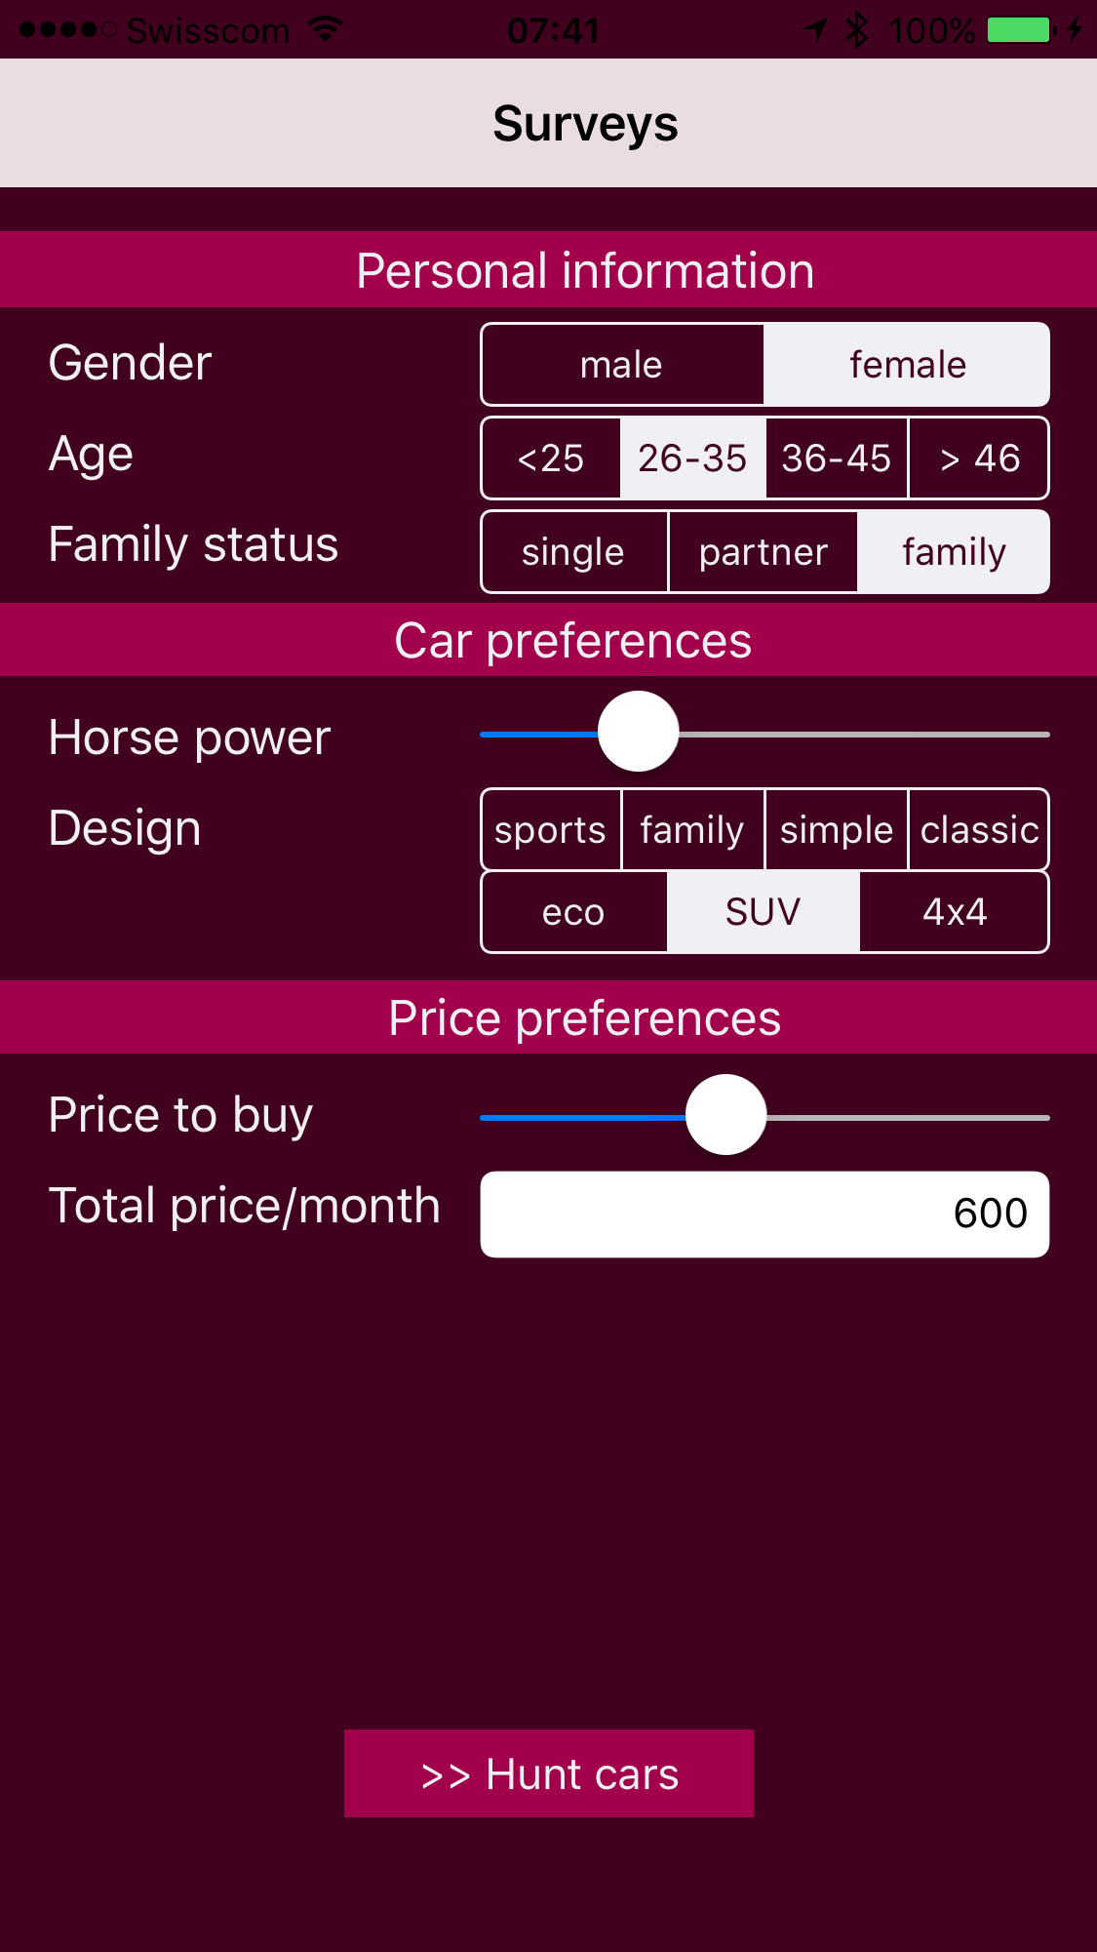

Slide 7
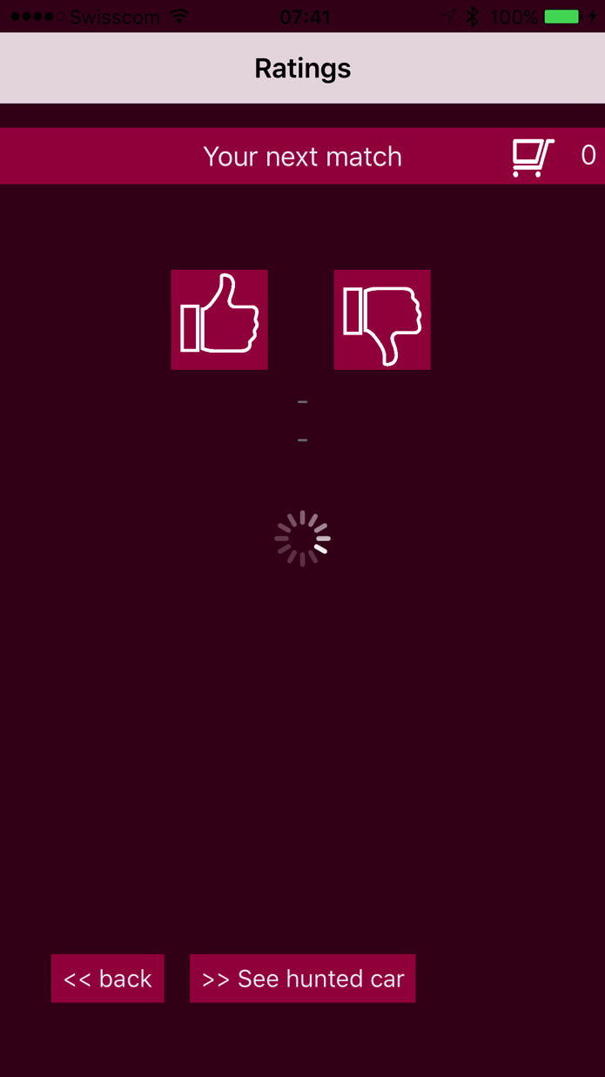

Slide 8
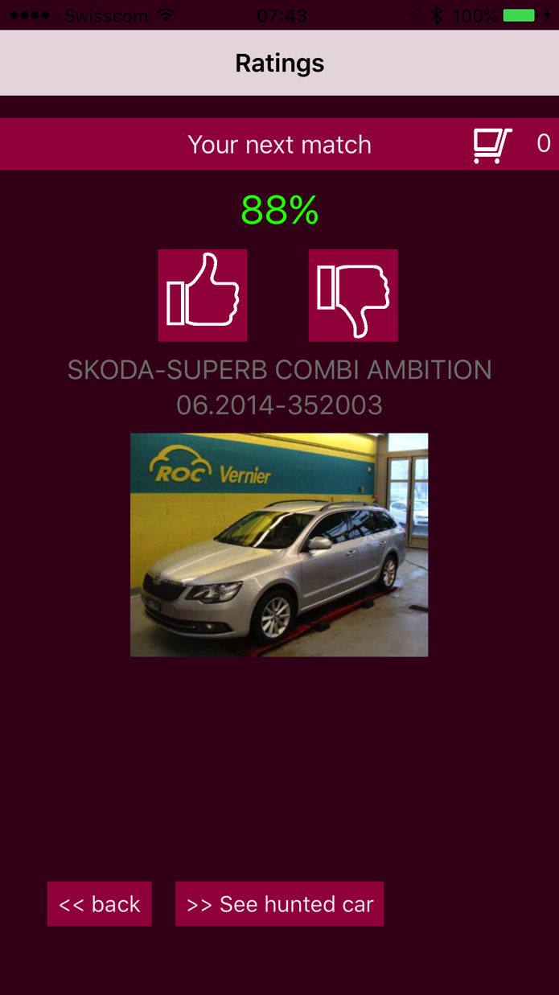

Slide 9
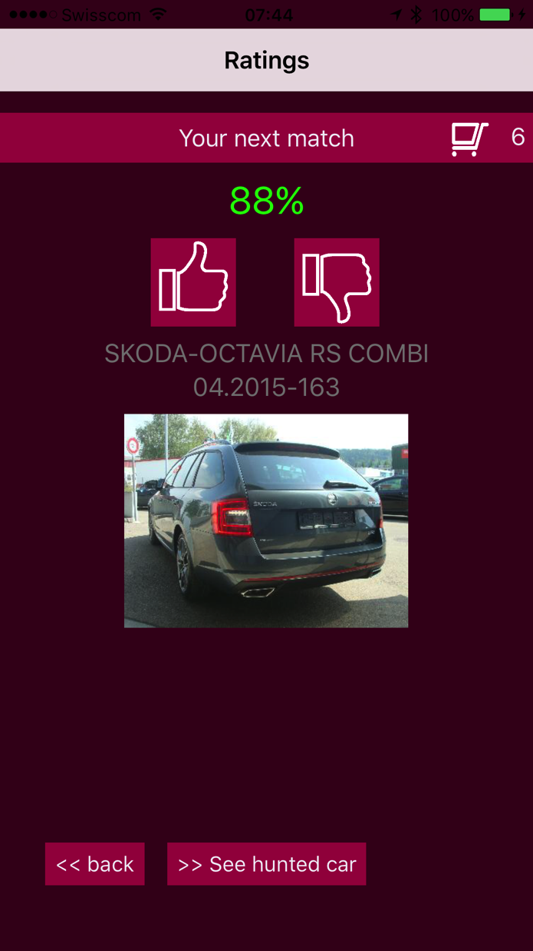

Slide 10
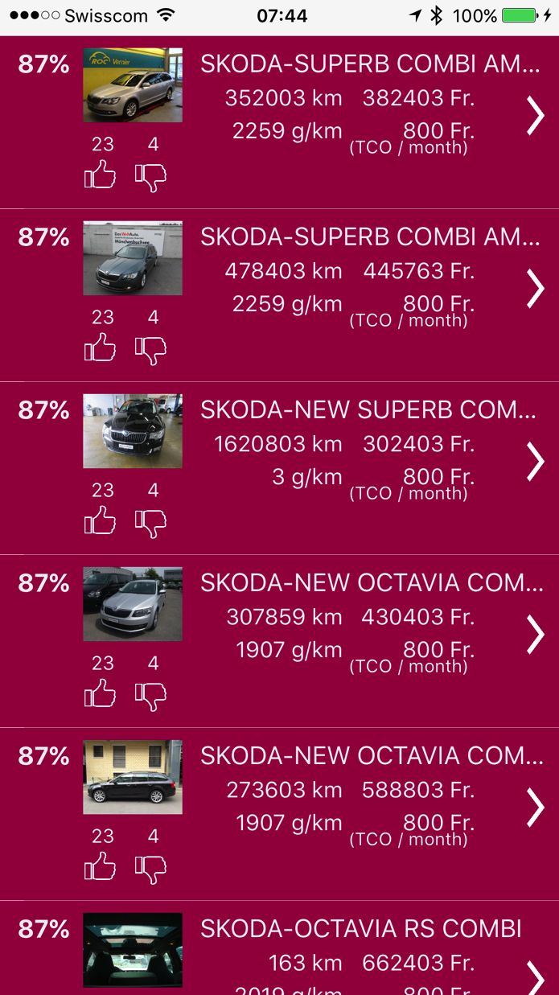

Slide 11
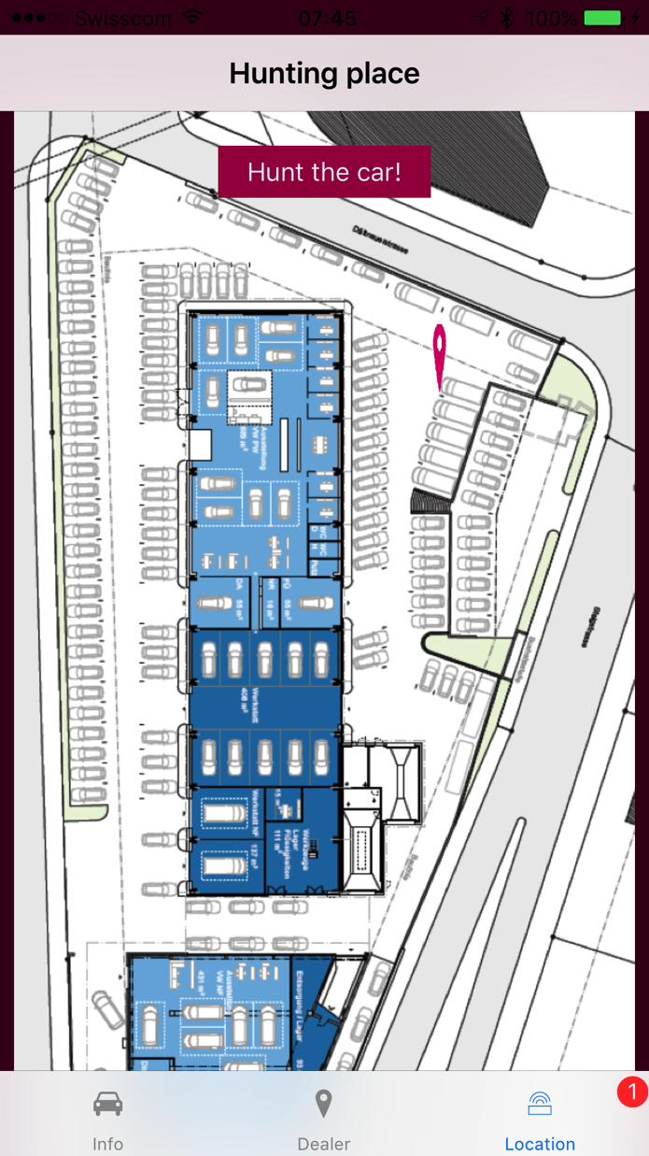
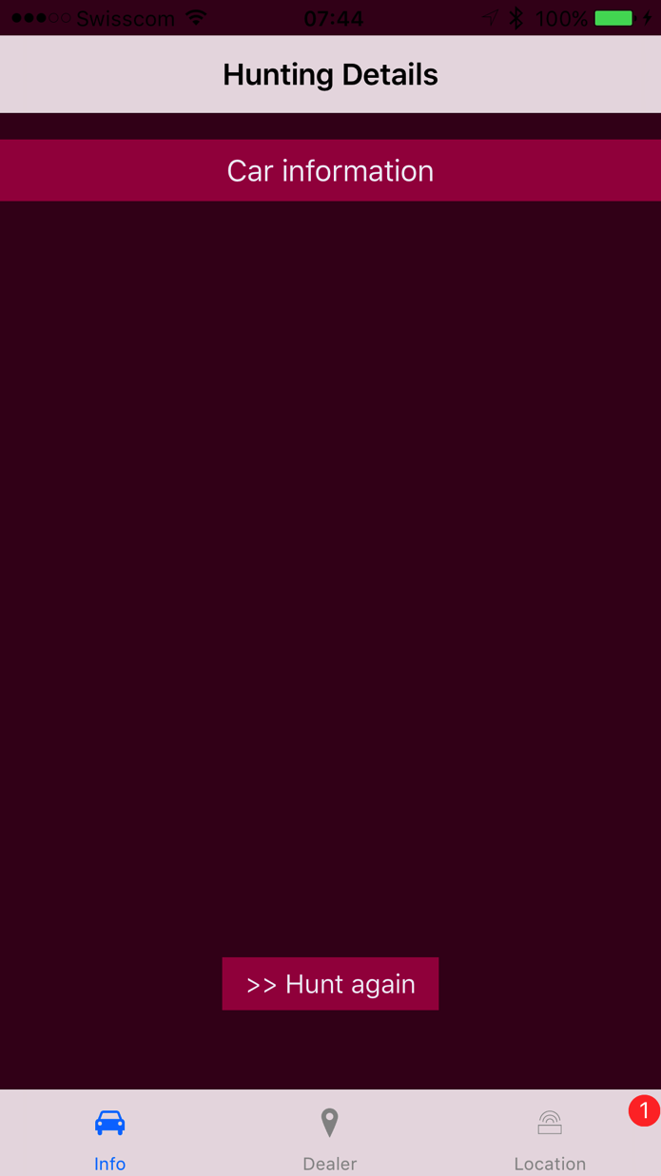
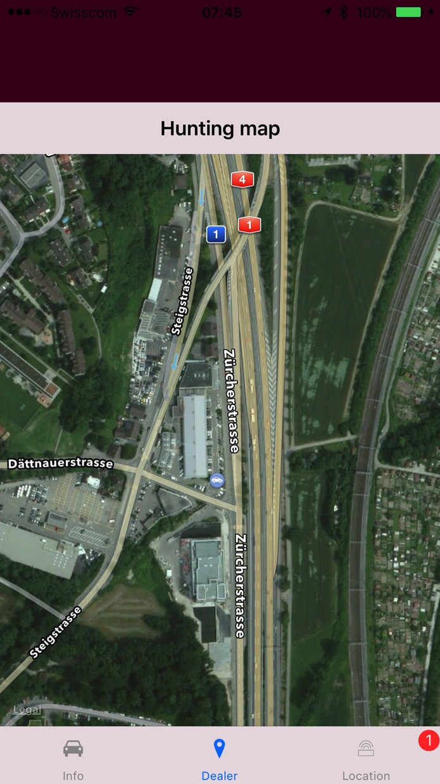

Slide 12
Thank you

